Slide 1
LAB CONFIGURATION

Slide 2

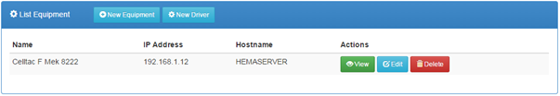
Instrumentation user interface
This can be accessed from the link, then click the sub menu on the navigation menu.
The default page shows a list of all Equipment already configured for use.

Slide 3
Configuring Equipment Drivers
Driver files tell kBLIS how to access test information from analyzers. A driver implementation should publish following information:
the equipment name
a unique identification code
a description of the equipment
the medical tests it can perform.
To import a driver file,
Click on the button on the Equipment List page.
In the dialog box that appears, click the or button to open a files dialog box

Slide 4
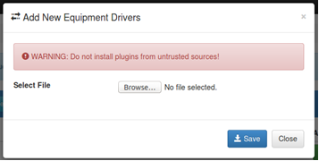
Continuation….

Slide 5
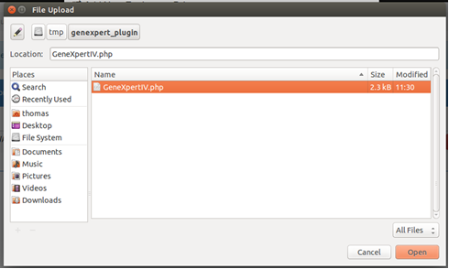
Continuation….
Select a driver file

Slide 6
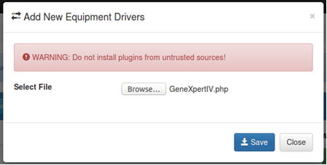
Continuation….
iv. Save the driver file.

Slide 7
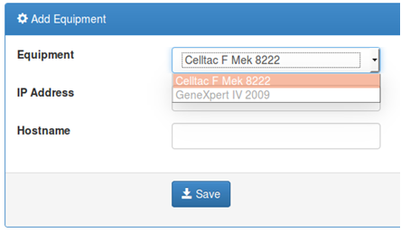
Continuation….
The new driver will now be listed as one of the available drivers.

Slide 8

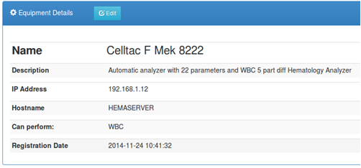
View Equipment Details
Clicking the button displays the details of the listed equipment

Slide 9

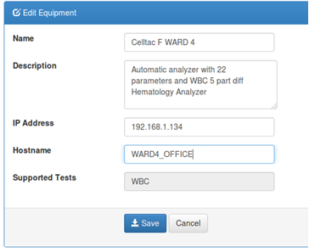
Update Equipment Details
The button allows for changing the details of the listed equipment including:
name
description
ip address
host name

Slide 10
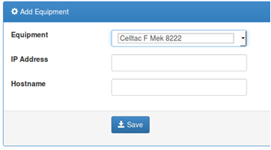
Adding A New Equipment
In this step, the user defines the location of a particular machine by specifying the IP address and optionally the hostname to which the machine is attached.
1. The process is initiated by clicking on from the Equipment List page.
2. Click the button to save the details.

Slide 11

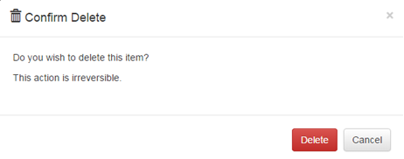

Deleting Existing Equipment
1. Click the button on the equipment list page for corresponding equipment
2. Click the button on the pop-up if you are sure to delete, otherwise, click the button or icon to dismiss.

Slide 12
Facilities
Allows for the definition of other health facilities which do referrals to the lab or we refer tests to. Most are satellite facilities.

Slide 13
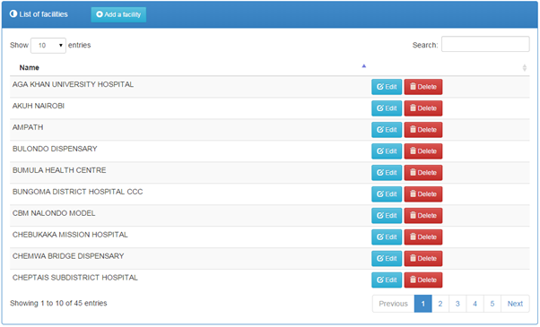
Listing Existing Facilities
1. Click the link on the navigation menu.
2. The list of facilities will be loaded as shown below.

Slide 14

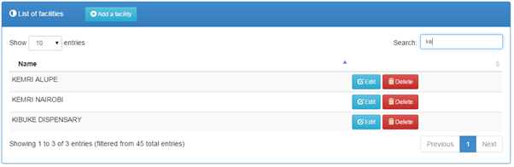
Searching for a Facility
1. Begin typing the name of the facility in the search filed provided
2. The list will automatically be loaded with matching values e.g.

Slide 15
Adding a new Facility
1. Click the button to load the new facility details form.
2. Complete the form as appropriate.
3. Click the button to save the details.

Slide 16
Updating a Faculty’s Details
1. Click the button of the corresponding record to open a form with pre-filled values.
2. Make the necessary modifications to the details presented.
3. Click the button to save the details.

Slide 17

Deleting a Faculty
1. From the list of facilities, click the button of the corresponding record
2. Click the button on the pop-up if you are sure to delete, otherwise, click the button or icon to dismiss.

Slide 18
Surveillance
Allows for the definition of the different test parameters for a particular disease available in the system and adding new diseases.

Slide 19
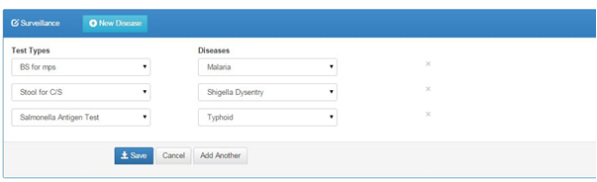
Listing Existing Surveillances
1. Click the link on the navigation menu.
2. The list of tests and diseases will be loaded as shown below.

Slide 20
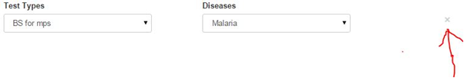
Removing a Test and its Disease
Click the X button as shown below

Slide 21

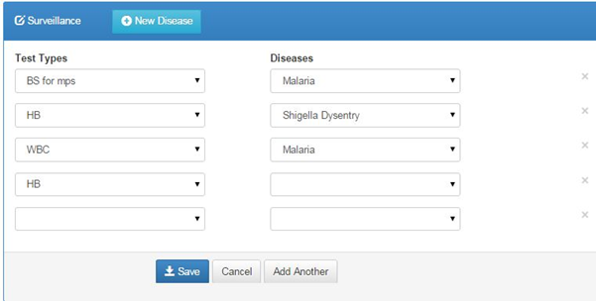
Adding new configuration, new test and Disease for Surveillance
1. Click the button to load drop down combo boxes where you will be able to select test and disease alongside one another.
2. Complete the form as appropriate.
3. Click the button to save the details.

Slide 22

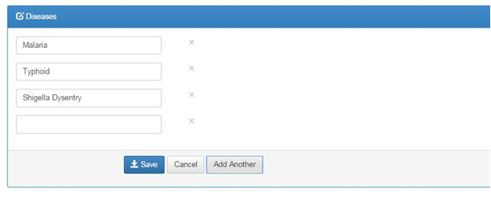
Adding new Disease for the Surveillance
1. Click the button to load a text field.
2. Complete the field as appropriate.
3. Click the button to save the details

Slide 23
Verification
This specifies the duration it takes to verify a specimen.
To configure the verification click on the verification option under lab configuration.
The below window will show.

Slide 24
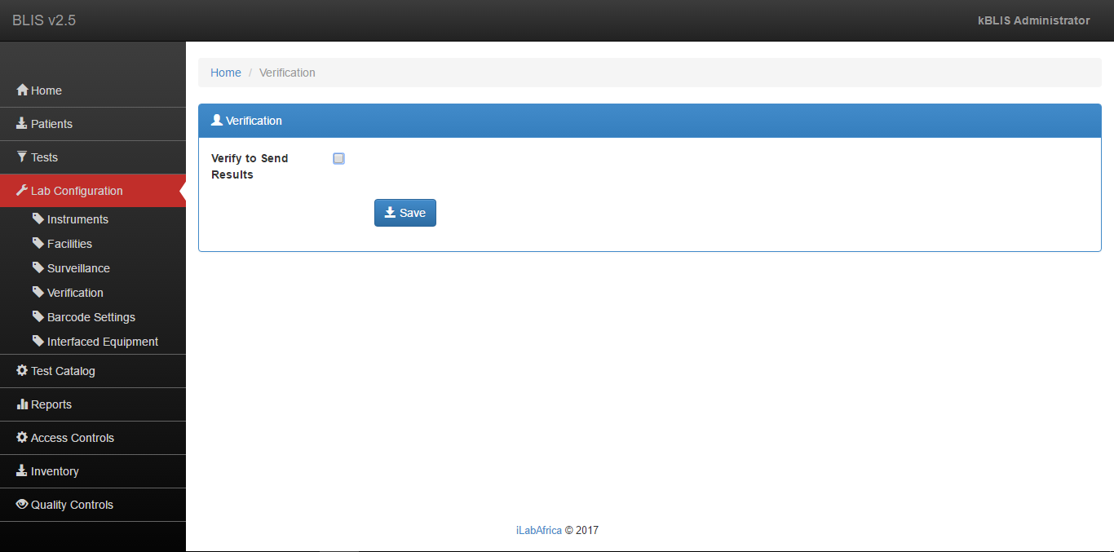
Continuation…

Slide 25
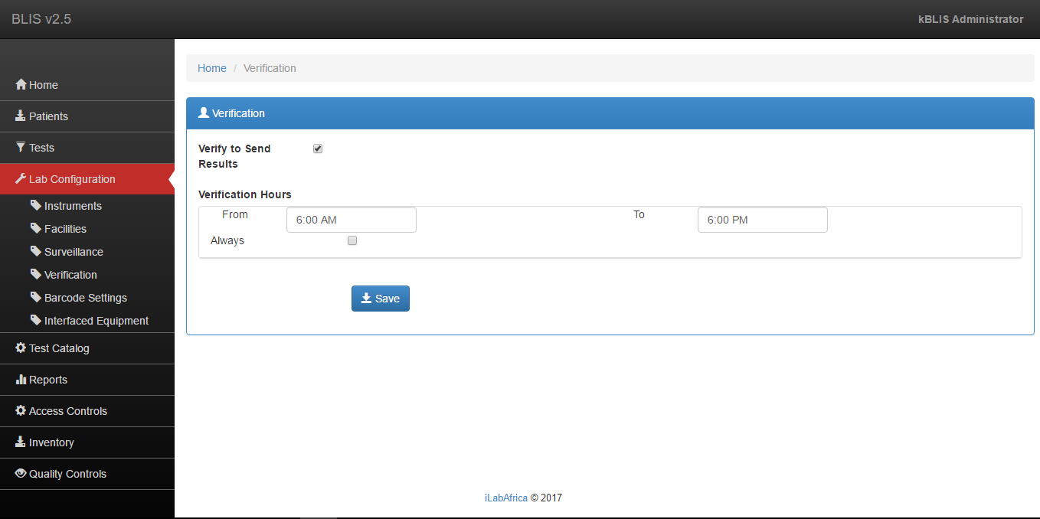

Continuation…
2. Click on the checkbox to show the verification hours as shown below.
3. The click on the button to save the changes.

Slide 26
Barcode Settings
This helps in the tracking of the specimens from when they are collected and go through the entire process of testing.
To configure the barcode;

Slide 27
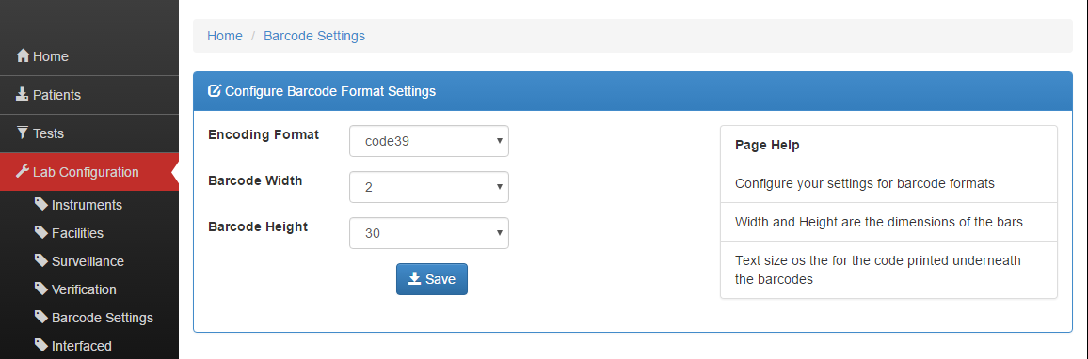
Continuation…
1. Click on Lab Configuration. A screen will appear as the one shown below;

Slide 28
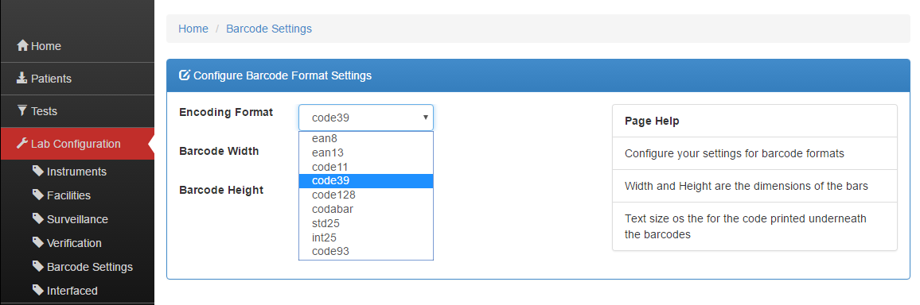
Continuation…
2. Then configure the encoding format. To configure it click the dropdown arrow, a list of encoding formats will appear as shown below;

Slide 29
Continuation…
3. Then choose a suitable encoding format from the list above.
4. Finally configure the barcode height and width as you desire. The width and height are the dimensions of the bars of the barcode

